Slide 1
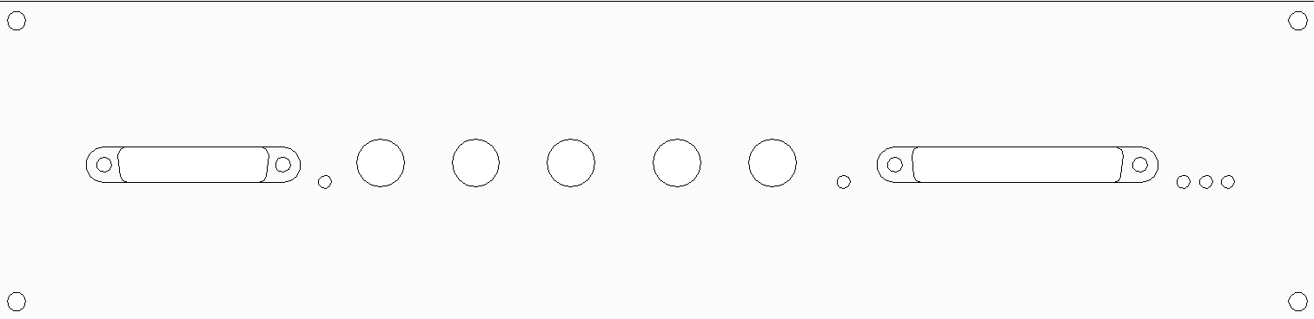
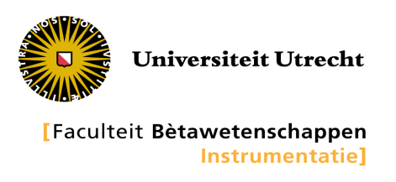
DIGITAL IO
DIG-IN
DIG-OUT
TRIGGER
FADC1
FADC2
ANALOG IO
USB
POWER
STATUS
DIGITAL STATUS
ANALOG STATUS
JULIAIII

